Slide 1
Welcome! A few things before we get started...
Please respond to this question in the chat
Type in the chat: What is the thing you are most excited to do in your classes once we arrive at our post-pandemic normal?
Start thinking about which question you would like to explore in your breakout rooms:
Academic Integrity: How do we help students to understand which tools support learning and which undermine learning in your active online course?
Student Engagement: What is reasonable to expect of students in terms of engagement in your active online course?
Work/Life Balance: What is reasonable in terms of making accommodations to meet individual student needs in your active online course?
Notes:
Julia

Slide 2

Towards an Equitable Active Online Classroom: Troubleshooting Scenarios Together
Alison Marzocchi, California State University Fullerton
Julia Olkin, California State University East Bay
Elizabeth Thoren, Pepperdine University
Notes:
Elizabeth

Slide 3
Overview - 3 Driving Questions
Academic Integrity: How do we help students to understand which tools support learning and which undermine learning in your active online course?
Student Engagement: What is reasonable to expect of students in terms of engagement in your active online course?
Work/Life Balance: What is reasonable in terms of making accommodations to meet individual student needs in your active online course?
Notes:
Elizabeth: The global pandemic and abrupt shift to online teaching presents new tensions and magnifies old tensions as we reconfigure our classrooms for equitable, active engagement in virtual settings. There are no easy answers to these dilemmas, but let’s troubleshoot together. In this interactive session we will bring the participant community together to share ideas and process new tensions around academic integrity, student engagement, and how to be reasonably accommodating as we strive to provide our students with active equitable virtual classes.

Slide 4
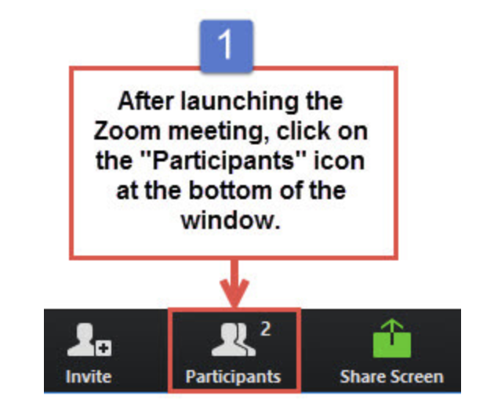
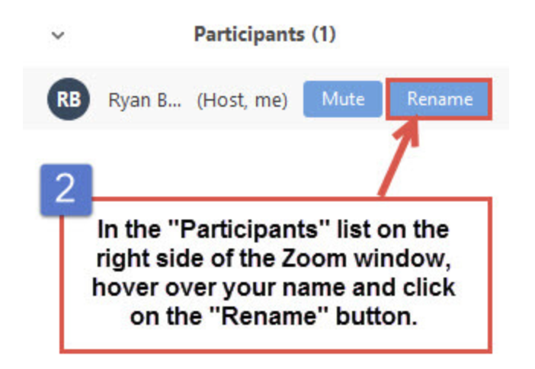
Change your Zoom name to let us know which driving question most interests you:
Academic Integrity
Student Engagement
Work/Life Balance
Example: C Julia Olkin
Notes:
Elizabeth

Slide 5
Proposed commitments for our time together
Engage/listen to be changed.
Expect messiness.
Share your ideas, share the space.
Work within the tension (consensus is not the goal).
Notes:
Elizabeth

Slide 6
Overall Structure of Meeting
Two rounds of Troubleshooting Scenarios Together
Blue Round: You’ll discuss ONE of the Round 1 scenarios.
(15 min) Breakout: Discuss your group’s scenario and record the group’s ideas in the slides.
Whole Group: Some Reporters will share some ideas from their discussion.
Green Round: You’ll discuss ONE of the Round 2 scenarios.
(15 min) Breakout: Discuss your group’s scenario and record the group’s ideas in the slides.
Whole Group: Some Reporters will share some ideas from their discussion.
Notes:
Alison - (Elizabeth put link into chat)

Slide 7
Team Roles (start by assigning roles based on family size*)
Smallest Family
The reporter is ready to share out the group’s observations, ideas, and questions when the whole group comes together.
The notetaker has a copy of the Google Slides open and is adding the group’s notes and observations.
The manager will paste the scenario, keep track of time, and keep track of any message to the breakout room.
The balancer helps make sure everyone has a chance to speak.
*it is up to your group to define “family size”
Largest Family
Notes:
Alison

Slide 8
A: ACADEMIC INTEGRITY BLUE ROUND
C: WORK/LIFE BALANCE BLUE ROUND
B: STUDENT ENGAGEMENT BLUE ROUND
Collaboration? A student asks a question about another student’s homework solution that they saw on shared media (Discord, jamboards, Google slides). You are suddenly made aware that your students have been posting their solutions to homework problems online all semester long.
How do we help students to understand which tools support learning and which undermine learning in your active online course?
Parallel Isolation: You pop into a breakout room and all mics are muted, cameras are off and there’s no sign that the students are working together (but there is evidence that students are working in isolation on collaborative document).
What is reasonable to expect of students in terms of engagement in your active online course?
Absent Student: You have a student who regularly needs to miss class meetings due to family obligations; however, the in-class activities are central to the learning in the class so don’t want students to miss this opportunity.
What is reasonable in terms of making accommodations to meet individual student needs in your active online course?
Notes:
Alison

Slide 9

Breakout Rooms Blue Round
15 minutes to discuss Scenarios in your breakout rooms.
Notes:
Julia - Show logistics of slide 10 - make sure everyone has access.

Slide 10
Breakout Group 0
Notetaker -- Record the main ideas from your group’s discussion here:
3
1
Add your names (roles on yellow slide 7):
Reporter: Alison
Note taker: Elizabeth
Manager: Julia
Balancer: Jeremy
2
Manager -- copy and paste your group’s scenario from Slide 8 here.
Absent Student: You have a student who regularly needs to miss class meetings due to family obligations; however, the in-class activities are central to the learning in the class so don’t want students to miss this opportunity.
What is reasonable in terms of making accommodations to meet individual student needs in your active online course?

Slide 11
Breakout Group 1
Notetaker -- Record the main ideas from your group’s discussion here:
Use discussion boards to hide responses until students post their own response. Respond to at least 2 peers and learn from other’s solutions.
Facilitate asynchronous collaboration using Discord or other platform.
Have conversation with students that the problems in class have already been solved. In their careers, they’ll be presented with problems that nobody has solved. Employees who can problem-solve and think critically about how to solve a problem will go far in their careers. Looking up answers for points is not going to prepare them for the future. Now is the time for them to train their brains and learn skills that they will take with them. Emphasize problem-solving and critical thinking. Struggling doesn’t mean that you can’t solve the problem.
3
1
Add your names (roles on yellow slide 7):
Reporter: Kathy
Note taker: Kristin
Manager: Nadezhda
Balancer:
2
Manager -- copy and paste your group’s scenario from Slide 8 here.
Collaboration? A student asks a question about another student’s homework solution that they saw on shared media (Discord, jamboards, Google slides). You are suddenly made aware that your students have been posting their solutions to homework problems online all semester long.
How do we help students to understand which tools support learning and which undermine learning in your active online course?

Slide 12
Breakout Group 2
3
Notetaker -- Record the main ideas from your group’s discussion here:
This scenario has happened before
It may depend on the type of class, class size (do certain activities require the camera to be on?)
Expectations could be different for different tasks (for example, having the camera on for ice breakers)
Reasonable to have them work collaboratively on a shared space (if they do not, it is difficult to gauge learning)
If the meeting is synchronous, then students should be expected to participate in the activity/lecture/class (participation could vary between cameras on, sending reactions, sharing what they learned from each other)
1
Add your names (roles on yellow slide 7):
Reporter: Lynda Wynn
Note taker: Mario Banuelos
Manager: Asuman Oktac
Balancer: Chris Rasmussen
2
Manager -- copy and paste your group’s scenario from Slide 8 here.
Parallel Isolation: You pop into a breakout room and all mics are muted, cameras are off and there’s no sign that the students are working together (but there is evidence that students are working in isolation on collaborative document).
What is reasonable to expect of students in terms of engagement in your active online course?

Slide 13
Breakout Group 3
Notetaker -- Record the main ideas from your group’s discussion here:
Use online Smartboard, see the student’s work and choose to share it with class
Use GeoGebra, collaborate with students
Randomly pick up students to answer questions, 5% of grade being attendance and discussion
Get students to share their work on computer programming
Incentive of attendance: Students can add two entries to their resume in one course
3
1
Add your names (roles on yellow slide 7):
Reporter: Tuyin
Note taker: Sam
Manager: Julian
Balancer: Julian
2
Manager -- copy and paste your group’s scenario from Slide 8 here.
Student engagement
Parallel Isolation: You pop into a breakout room and all mics are muted, cameras are off and there’s no sign that the students are working together (but there is evidence that students are working in isolation on collaborative document).
What is reasonable to expect of students in terms of engagement in your active online course?

Slide 14
Breakout Group 4
Notetaker -- Record the main ideas from your group’s discussion here:
Breakout rooms quiet, not effective, Jam board, external USB mailed to house. Don’t get to know each other. Smiley face.
Desmos Slides Anonymize, search in google
Private chat to instructor
Working microphone
Meet on zoom outside of class for points.
No nonverbal clues to engagement
Discord
3
1
Add your names (roles on yellow slide 7):
Reporter: Simone
Note taker: Sara
Manager: Su
Balancer: Michelle
2
Parallel Isolation: You pop into a breakout room and all mics are muted, cameras are off and there’s no sign that the students are working together (but there is evidence that students are working in isolation on collaborative document).
What is reasonable to expect of students in terms of engagement in your active online course?

Slide 15
Breakout Group 5
Notetaker -- Record the main ideas from your group’s discussion here:
Like the idea of the collaborative doc
Use breakout as opportunity to talk about math + life -- engaging when you have topic that is relevant
Using roles to help -- accountability
Remember the THINK in the think/’pair”/share
Harder to come up with positive reinforcement
3
1
Add your names (roles on yellow slide 7):
Reporter: Shawn/Dianne
Note taker: Kathryn
Manager: David
Balancer: Shirley
2
Manager -- copy and paste your group’s scenario from Slide 8 here.
Parallel Isolation: You pop into a breakout room and all mics are muted, cameras are off and there’s no sign that the students are working together (but there is evidence that students are working in isolation on collaborative document).
What is reasonable to expect of students in terms of engagement in your active online course?

Slide 16
Breakout Group 6
Notes from discussion
Record the class so it is available for students who missed it.
Use asynchronous discussion board to continue the discussion about the problems from class.
Use your own discussion board vs students going to outside websites for resources.
Use a whiteboard to go over the activities as “in-person”.
Is it possible to engage in the activity later on? Is there a way to engage with it later on.
Use engagement points: post on discussion board, office hours, post an interesting math fact. Be flexible with ways to engage.
We are asked to be flexible with students, but are others flexible with us?
Are students managing synchronous and asynchronous classes?
Missing class vs missing preparing class: the asynchronous preparation component can still be expected.
3
1
Add your names (roles on yellow slide 7):
Reporter: Asmita
Note taker: Francesca
Manager: Roberto
Balancer: Julie
2
Manager -- copy and paste your group’s scenario from Slide 8 here.
Absent Student: You have a student who regularly needs to miss class meetings due to family obligations; however, the in-class activities are central to the learning in the class so don’t want students to miss this opportunity.
What is reasonable in terms of making accommodations to meet individual student needs in your active online course?

Slide 17

Reports from Blue Round Discussions
Notes:
Alison

Slide 18
A: ACADEMIC INTEGRITY GREEN ROUND
B: STUDENT ENGAGEMENT GREEN ROUND
C: WORK/LIFE BALANCE GREEN ROUND
Learning Tools: You are teaching a lesson that expects your students to build understanding on their own. However, you realize some students are googling concepts that you ordinarily would not allow in a face-to-face classroom.
How do we help students to understand which tools support learning and which undermine learning in your active online course?
Split Attention: You have a student who is regularly either driving or cooking dinner for family while attending synchronous class sessions. This student is engaged in other course components.
What is reasonable to expect of students in terms of engagement in your active online course?
Deadline Extensions: A student asks if they can turn in the homework one day late because they were helping their 6th grader with her homework. Do you extend the deadline for everyone? Do you continue to allow this for the same student? What if it were the midterm instead of homework?
What is reasonable in terms of making accommodations to meet individual student needs in your active online course?
Notes:
Elizabeth

Slide 19
Breakout Rooms Green Round
15 minutes to discuss Scenarios in your breakout rooms.
Notes:
Julia - logistics of new slide.

Slide 20
Breakout Group 1
Notetaker -- Record the main ideas from your group’s discussion here:
Ask students concept questions that probe the ideas further. This would be a way to counteract after the fact, but how do we get students to buy in and not google?
Working in group where one person does the work and others copy the answer. Ask students if they learn from that? They learn to copy down the answer. The purpose should be to learn to deal with a new concept.
Not everything will have an answer that is “Google-able”
Ask them how they know that what they find on Google is true?
Ask poll questions to get at difficult concepts.
Googling is okay in some scenarios (e.g., a specific word you don’t understand) but challenge them to do their initial thinking away from Google. Discussion about what types of things are “okay” to look up online.
Analyze the way you might use Google to learn something.
Ask students to come up with examples or counterexamples which would push their understanding beyond what they may have found on the internet
You could assign students to Google things and see if they found different definitions (Wolfram Math World, Wikipedia, etc.) and compare the definitions
3
1
Add your names (roles on yellow slide 7):
Reporter: Kathy
Note taker: Kristin
Manager: Nadezhda
Balancer: Silvia
2
Manager -- copy and paste your group’s scenario from Slide 18 here.
Learning Tools: You are teaching a lesson that expects your students to build understanding on their own. However, you realize some students are googling concepts that you ordinarily would not allow in a face-to-face classroom.
How do we help students to understand which tools support learning and which undermine learning in your active online course?

Slide 21
Breakout Group 2
Notetaker -- Record the main ideas from your group’s discussion here:
Communicating about missed material with other students
Perhaps speaking with the student, but it may depend on how well the student is doing in the course
If students sign up for a synchronous class session, the expectation is that they would be available at that time
3
1
Add your names (roles on yellow slide 7):
Reporter: Lynda
Note taker: Mario
Manager: Asuman
Balancer: Chris
2
Manager -- copy and paste your group’s scenario from Slide 18 here. Split Attention: You have a student who is regularly either driving or cooking dinner for family while attending synchronous class sessions. This student is engaged in other course components.
What is reasonable to expect of students in terms of engagement in your active online course?

Slide 22
Breakout Group 3
Notetaker -- Record the main ideas from your group’s discussion here:
Common problem
Students driving, students at work
Remind students that it is not what they would be doing in-person
Students don’t realize that this is hindering their learning and performance
Syllabus: test equipment, Accommodate students who need to join a different section
Syllabus: research about multitasking and that people convince themselves about their ability to do it, even when it doesn’t work
http://reyjunco.com/wordpress/pdf/JuncoMultitaskingCHB2012.pdf
3
1
Add your names (roles on yellow slide 7):
Reporter: Julian
Note taker: Kevin
Manager: Tuyin
Balancer: Michael
2
Split Attention: You have a student who is regularly either driving or cooking dinner for family while attending synchronous class sessions. This student is engaged in other course components.
What is reasonable to expect of students in terms of engagement in your active online course?

Slide 23
Breakout Group 4
Notetaker -- Record the main ideas from your group’s discussion here:
How would we know? They are a muted black box.
Driving and cooking are different! Not safe.
We understand the need to multitask
Sessions are recorded
Depends on how student is doing
Most can’t successfully multitask
Individual coaching
Googling or coming in at the end does not promote the learning gained from the struggle.
Idk in individual chat
Self report
3
1
Add your names (roles on yellow slide 7):
Reporter: Simone
Note taker: Sara
Manager: Su
Balancer: Michelle
2
Split Attention: You have a student who is regularly either driving or cooking dinner for family while attending synchronous class sessions. This student is engaged in other course components.
What is reasonable to expect of students in terms of engagement in your active online course?

Slide 24
Breakout Group 5
Notetaker -- Record the main ideas from your group’s discussion here:
It’s good to be accommodating
Rearranging schedule? Dinner at a different time
Otherwise engaged: Is the student doing the work, participating?
Classroom contract/norms /expectations, being a team
What does “otherwise engaged in the course” mean?
Giving students feedback early on
Injecting humor, “left the building”
Last semester a learning experience
3
1
Add your names (roles on yellow slide 7):
Reporter: Shawn/Diane
Note taker: Kathryn
Manager: David
Balancer: Shirley
2
Manager -- copy and paste your group’s scenario from Slide 18 here. Split Attention: You have a student who is regularly either driving or cooking dinner for family while attending synchronous class sessions. This student is engaged in other course components.
What is reasonable to expect of students in terms of engagement in your active online course?

Slide 25
Breakout Group 6
Notetaker --
Life happens clause: automatically give and extension for the next 24 hours (If they ask? Not even needing to ask)
Choose the problems to work on, and the students discuss the solutions on discussion boards so they are “already there” they just need to write them up. “Pick the ones the worry you the most”. But also check in with the graders
Looking for confirmation is ok, but it’s more important to find ways to connect with the class community.
Large classes -> need homework system BUT have them turn in one written question each week (and drop a certain number of them)
The deadline is not the point… the learning is the point.
What kind of assessment? Mastery Based Grading? Try to differentiate between skills and more conceptual questions
Give options for reassessment so that if they miss anything, you can reassess.
3
1
Add your names (roles on yellow slide 7):
Reporter: Asmita
Note taker: Francesca
Manager: Roberto
Balancer: Julie
2
Deadline Extensions: A student asks if they can turn in the homework one day late because they were helping their 6th grader with her homework. Do you extend the deadline for everyone? Do you continue to allow this for the same student? What if it were the midterm instead of homework?
What is reasonable in terms of making accommodations to meet individual student needs in your active online course?

Slide 26
Reports from Green Round Discussions
Notes:
Alison

Slide 27
COMMIT-CaN Sessions in MC^2:
March 12th: Supporting Inquiry in Remote Teaching: Challenges depend on class size/format.
March 19th: Show and Tell (and Experience): Online teaching, learning, and assessment for mathematics.
Notes:
Elizabeth

Slide 28
Thank you!
California and Nevada locals: If you are interested in learning about more events like this one or joining a local community of educators and education researchers who seek to promote, encourage, and support high-quality inquiry teaching through collaboration and community -- join the COMMIT-CaN Google group.
Not in CA or NV? Find a COMMIT near you at https://www.comathinquiry.org/
Notes:
Elizabeth

